Slide 1
In all that we do, our values shine through
Eardisley CE Primary School

Slide 2
What kind of learners do we want to grow…?
… What kind of world do we want to create?
Notes:
Comes down to this. What kind of world do we hope to make? This is where it starts.
is about inviting children to take a step through life itself.
Values pre-exist – prehistoric ‘In the air we breathe’ and part of every culture throughout humanity
I used to see VbE for its softening effect – making people more mannerly, less harsh, more understanding – still think that but also see how strengthening and empowering.
Research findings consistently point to notable improvement in student
Well-being
Self esteem
Behaviour
Relationships
Emotional, moral and spiritual intelligence
Academic diligence
Academic achievement.

Slide 3
Our Eardisley Vision
In all that we do, our values shine through. At Eardisley CofE Primary School, our vision is to live out the Christian teaching, to ‘love one another’ (John 15:12). This vision is rooted in our shared values which will guide, inspire and nourish, bringing joy to all.
Notes:
At Eardisley CE Primary School, God’s love is our motivation, our lifeforce and our fulfilment. We determine to go well beyond the more transactional motivation to do unto others as we would have done unto us. Following Christ’ teaching and footsteps, we determine to love one another in friendship with our hearts, in our thoughts and deeds so that all may experience the joy of life in all its fullness.
This vision of the potency of love informs the vibrant and creative ethos, enabling a culture of great and tender care for individuals and our school. In turn, this creates a momentum for achieving the very best that we are able.
The vision is borne out in the success of our school as the hub of the local community; in the excellent behaviour and responsiveness of our pupils; in high academic and personal development standards; in our fantastic reputation for meeting a vast range of individual and additional needs, and in attention to staff welfare.

Slide 4
.
Notes:
Taylor Swift’s August lyrics have the answer, borrowed from St Augustine."You are what you love." This profound statement encapsulates a fundamental aspect of human nature and spirituality that continues to resonate across centuries. At its core, Augustine's insight delves into the intricate interplay between our deepest desires, the formation of our character, and the pursuit of spiritual fulfillment.
The concept of being what we love speaks to the essence of human identity. It suggests that our true nature is not solely defined by our rational thoughts or intellectual beliefs, but rather by the objects of our affection and the pursuits that captivate our hearts. In essence, our loves shape our lives, molding our character and influencing our actions in profound ways.
It’s because VbE makes everything we do easier, more pleasant, more rewarding, more meaningful. Values are our super-power.

Slide 5
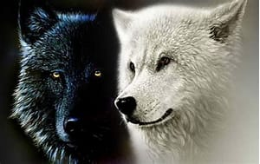

Slide 6
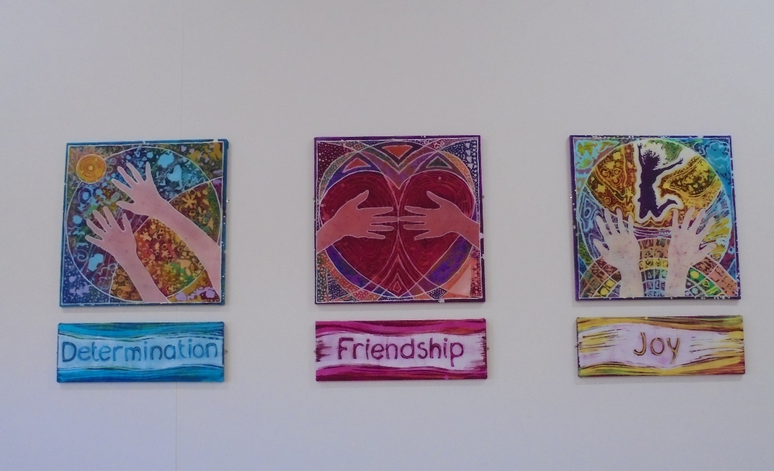
Values and Value of the Month
When schools to underpin their life and curriculum with universal positive human values this ethical vocabulary promotes ethical intelligence, leading to self-leadership, which enables each individual to take the lid off their potential…
Notes:
We show our friendship by being kind.
We help each other through the hard times. The value of Determination helps to power us through our work! Our school teaches us to enjoy the world, and to bring joy into it.

Slide 7
Cultural: Modelling and Leadership
Values influence you to be a better person.
Joe, 8 yrs
Notes:
Resilience is a virtue that children and adults need in an ever more challenging society. Pupils at effective VbE schools achieve higher levels of resilience as a result of their developed ethical vocabulary that enables them to discuss and share concerns with each other, plan next steps and solutions and evaluate theirs and others performance sensitively.
Cultural understanding through modelling and leadership
understanding and appreciation of the wide range of cultural influences that have shaped their own heritage and that of others
understanding and appreciation of the range of different cultures in the school and further afield as an essential element of their preparation for life in modern Britain
ability to recognise, and value, the things we share in common across cultural, religious, ethnic and socio-economic communities
knowledge of Britain’s democratic parliamentary system and its central role in shaping our history and values, and in continuing to develop Britain
willingness to participate in and respond positively to artistic, musical, sporting and cultural opportunities
interest in exploring, improving understanding of and showing respect for different faiths and cultural diversity and the extent to which they understand, accept, respect and celebrate diversity. This is shown by their respect and attitudes towards different religious, ethnic and socio-economic groups in the local, national and global communities
- We lead the way showing and demonstrating a oneness with others and the world, looking for peace not opposition, sowing seeds of reasonableness not Umbridge, modelling fascination, respect and honouring of the other.

Slide 8
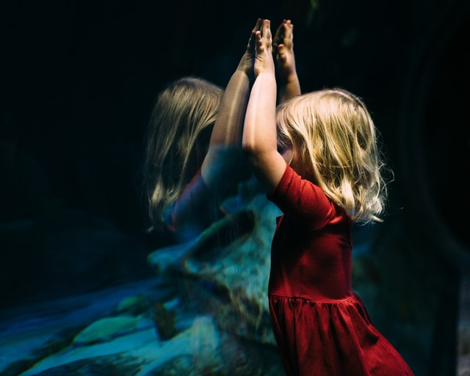
Social: ‘Unconditional positive regard’
Relationships
With the self
With others
With the world
Notes:
We all need to feel we are important in the lives of others. We grow in understanding ourselves in concert with others and our world.
Underpinning successful relationships of all kinds is ability to understand self, to be empathetic, to have desire to put values into action
To understand we all need one another and to work in harmony with the world
A way of becoming deeply connected with one another
OFSTED - Use of a range of social skills in different contexts, willingness to participate in a variety of communities and social settings, including by volunteering, cooperating well with others and being able to resolve conflicts effectively
acceptance of and engagement with the fundamental British values of democracy, the rule of law, individual liberty and mutual respect and tolerance of those with different faiths and beliefs. They will develop and demonstrate skills and attitudes that will allow them to participate fully in and contribute positively to life in modern Britain
Opportunities run through the subject disciplines – maths –money and division sharing and fairness… history – how groups have both battled and worked together for good – down the ages..
We all need to feel we are important in the lives of others. We grow in understanding ourselves in concert with others and our world.
Underpinning successful relationships of all kinds is ability to understand self, to be empathetic, to have desire to put values into action
To understand we all need one another and to work in harmony with the world
Here, it’s about teaching the heart to believe… to believe in yourself. You can do it.’

Slide 9
Moral: Ethical Vocabulary and Critical Thinking
Values helps us power through our work! (Ellie, 10 yrs.)
Notes:
It is well documented that P4C has an impact on children's cognitive, social and emotional development. P4C is about getting children to think and communicate well; to think better for themselves – and therefore to keep themselves safe.
Ability to recognise the difference between right and ;wrong understanding of the consequences of their behaviour and actions
interest in investigating and offering reasoned views; understand and appreciate the viewpoints of others
Basic premise of Values is treating one another with respect, civility and even kindness expect same in return. But when we delve more deeply into language of values and really examine in detail it allows us to understand more deeply. We come to define ourselves by our values. Ethical vocabulary: Language shapes our beliefs and becomes who we really are.. So language of values really powerful.
Subject opportunities for developing moral reasoning and critical thinking abound…
The values words themselves – love peace honesty are more than nomenclature, names, more than adjectives even verbs… they are the carriers guides, comforters, aspiration, joy open to paradox… we come to define ourselves and our lives by values

Slide 10
Spiritual: The Inner Curriculum
Dear God
Thank you for sharing your goodness.
Please give us peace in our hearts,
Love in our souls,
Kindness in our hands,
The strength to be hopeful and helpful.
So that we follow in Jesus’s footsteps.
In all that we do, may our values shine through.
In Jesus’s name,
Amen.
Notes:
ability to be reflective about their own beliefs (religious or otherwise) and perspective on life
knowledge of, and respect for, different people’s faiths, feelings and values
sense of enjoyment and fascination in learning about themselves, others and the world around them
use of imagination and creativity in their learning
willingness to reflect on their experiences
We actively show children how they can be at peace with themselves and how this manifests outwardly, maybe a sense of the numinous. Inner curriculum from which everything comes.

Slide 11
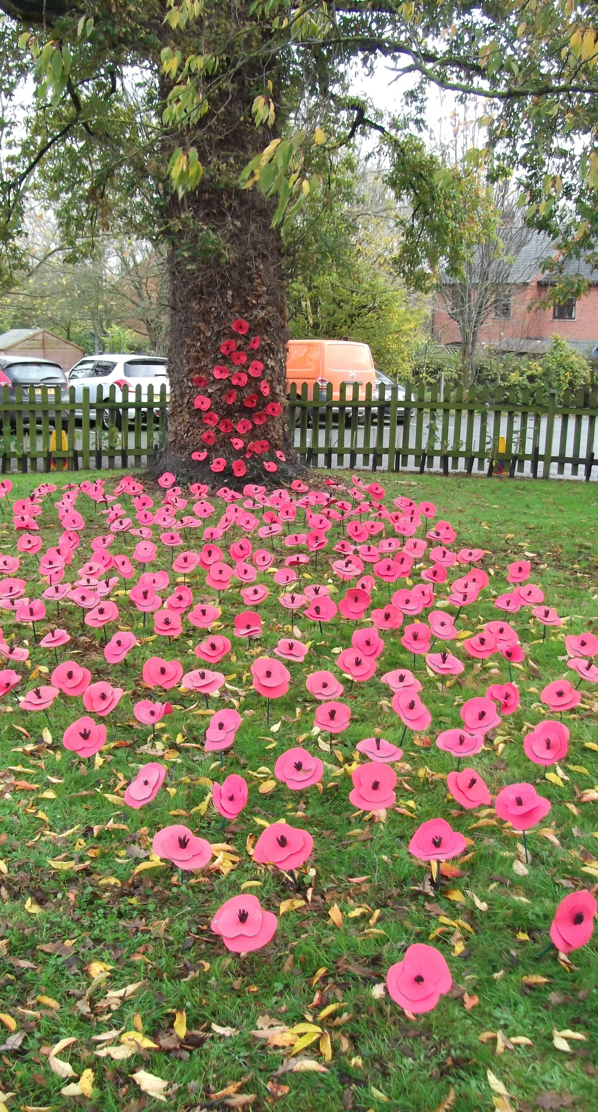
Values through the curriculum
…art
… Sport
… RE
…Music
…PSHE
…Science
…History
…Geography
…Design and Technology
Computing
… English
…Maths
Notes:
What we teach and how we teach it…Each subject offers its own unique contribution to SMSC development and to values understanding. Contention is that Subjects can serve a double duty – teach the requisite knowledge and skills but deepen the experience by drawing out values and ethics – we discover there are opportunities at every turn. Doesn’t detract/take longer -rather gives meaning and purpose and all instils
How to use the Values in Subject Sections:
Each section talks about the values-application to each individual subject. This is followed in each case with two lesson examples for Key Stage 1-3 showing which values can be drawn attention to for the learning, how values can be highlighted within the lesson, cross curricular links and then how the values message can be further deepened: taking the values into action.
Here we are simply scratching the surface: the closer you care to look at any subject through a values-based lens, the more there is to uncover. This is about making values explicit at times, while also recognising the power of messaging with implicit values.
Values links can be passing ones – there is value in this as it denotes the omnipresence of these tenets – but it is Important to guard against trite or tokenistic work. For example, if we talk about the value of self-belief, it is of less use to just say, ‘Let’s all have it’ without going into what self-belief is, what it can look like and how it can be gradually developed over time.
All required to schools deliver a broad and balanced curriculum.
All schools are also required to promote the spiritual, moral, social, cultural, mental and physical development of pupils at the school and of society; and prepare pupils at the school for the opportunities, responsibilities and experiences of later life.
Big part of curriculum.
Accompanying children on a journey to the heights of spirituality; helping them to experience the breadth of social and cultural understanding, and walking with them through the maze of moral aspects of our lives is an immense – a breathtaking privilege.
What our book shows is that subject disciplines do this naturally, meaningfully within a values-based culture.
Values makes me want to try even harder.
I
Practitioners can choose whether to champion their subject by making it the main driver for a values-based curriculum, or to be just more aware of the potential for drawing out social, cultural, moral and ethical and spiritual values as the opportunities present themselves. The following exemplifications will serve to show the potential for each subject area in this regard.
It is worth just saying at this point that while certain values are suggested, there are no ‘right’ or ‘wrong’ values – any investigation and discussion of one value is worthwhile in itself and inevitably leads in any case to consideration of a range of other values.
Most importantly, it is the person of the teacher who brings the values alive. Values reside in every subject and almost every aspect of every subject – but without the chorus of enthusiasm and approval by the teacher, they remain submerged and hidden. Values-based teaching needs the teacher to give it voice, prominence and importance – in your role, you could be that very person.

Slide 12
What difference does our values make to us?
Values help you to live your life in the best way possible.
Values build up your courage to face your fears.
They lead you through the darkest situations, the challenges of life, and out into the light of day.
Values give you energy – you see what they can do and it makes you feel positive to get through life.
Values are a part of life. It’s impossible to live without them.
My thought is that values are like the wind. You can’t see them, but you can feel them.
Values are the seeds – water them and show them the sun so that they will blossom and grow.
They’re the building blocks for my life. When you use them, it’s like a chain reaction.
Let your values pour into you, that’s my advice!
Think of your values like a rugby ball – pass them on!
Values light up our world!

Slide 13
In all that we do, living out the Christian vision to love one another.

