Slide 1
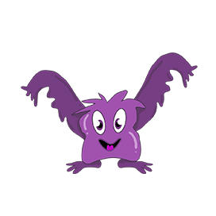




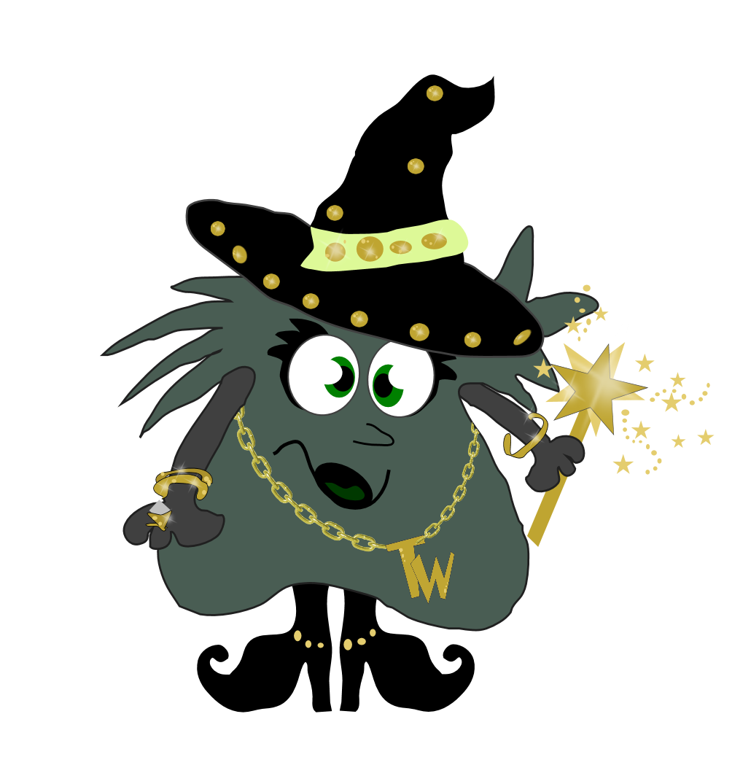
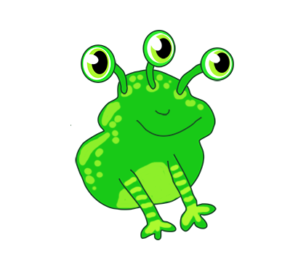
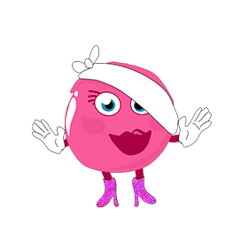


Phonics Workshop
2026

Slide 2
What is phonics?
Phonics is a way of teaching reading where children are taught to read by breaking down words into separate sounds or ‘phonemes’.
They are then taught how to blend these sounds together to read the whole word; Children will use their phonic (sounds) knowledge to read and spell words.
Why teach phonics?
Phonics helps children develop good reading and spelling skills.
The ability to read and write is a vital skill for all children, paving the way for an enjoyable and successful school experience.

Slide 3
Phoneme
The smallest unit of sound in a word.
There are 44 phonemes that we teach.
Grapheme
Is a letter or group of letters which represent one single sound (phoneme).
It is the way of writing down a phoneme. e.g. 1 letter - a, 2 letters - ck, sh, 3 letters - air, igh or 4 letters -ough

Slide 4
The 44 phonemes
/b/ | /d/ | /f/ | /g/ | /h/ | /j/ | /k/ | /l/ | /m/ | /n/ | /ng/
/p/ | /r/ | /s/ | /t/ | /v/ | /w/ | /y/ | /z/ | /th/ | /th/ | /ch/
/sh/ | /zh/ | /a/ | /e/ | /i/ | /o/ | /u/ | /ae/ | /ee/ | /ie/ | /oe/
/ue/ | /oo/ | /ar/ | /ur/ | /au/ | /er/ | /ow/ | /oi/ | /air/ | /ear/ | /ure/

Slide 5
Saying the sounds
Your child will be taught how to pronounce the sounds (phonemes) correctly to make blending easier.
Sounds should be sustained where possible (eg, sss, mmm, fff)
If not, ‘uh’ sounds after consonants should be reduced where possible
(eg, try to avoid saying ‘b-uh’, ‘c-uh’)

Slide 6
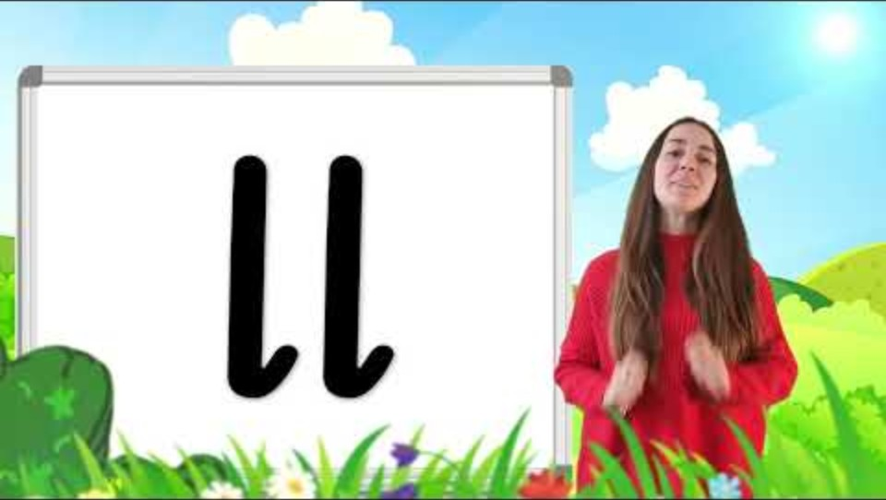
Saying the sounds

Slide 7
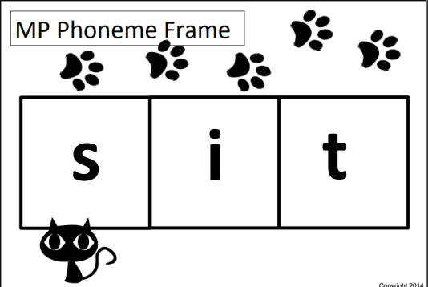
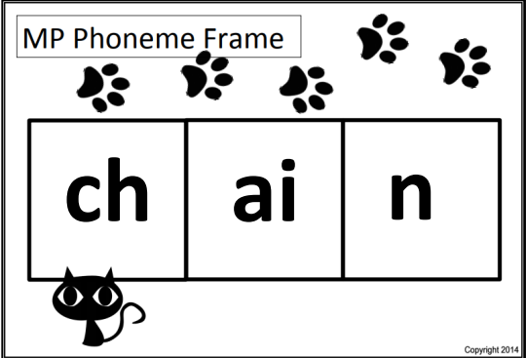
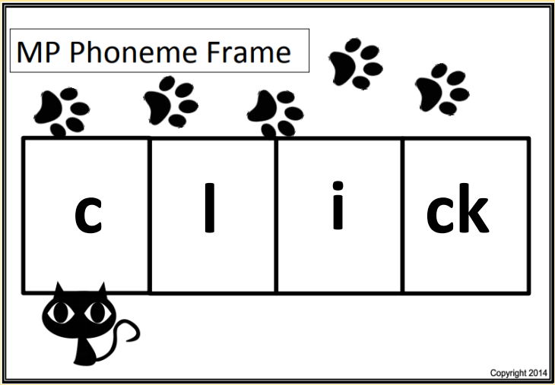
Counting the sounds
Children learn each letter by its phoneme, then later its name. Children will learn to use a phoneme frame and will understand that 1 box gets 1 sounds regardless of how many letters are in the sound.

Slide 8
Monster Phonics
Monster Phonics is the phonic scheme which we use here at Eardisley School
Monster Phonics is a multi-sensory approach to learning phonics.
It is engaging and each set of phonemes are colour coded.
Characters (monsters) are link to a colour, having the characters and colour coding makes it easier for the children to learn and recall their sounds and tricky words.
It engages the children by using all their senses. Lessons involve videos, action songs, games, story telling, use of magnetic letters, drawing, writing.
It makes phonics memorable and fun!

Slide 9
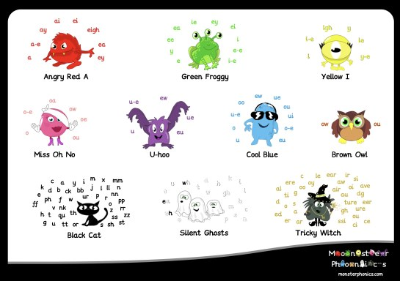
Phonic Sounds and Characters

Slide 10
How phonics is taught
Children have a daily 30minute phonic session. Sessions are split into four sections:
• Revisit & review the previous sound and word building.
• Teach a new phonic sound.
• Practise the new sound.
• Apply in different situations, e.g. reading in a sentence or writing the word in a sentence.
• Each lesson is planned with the use of visual, auditory and physical movements to help the children learn new phonic skills. Each sound comes with an action

Slide 11
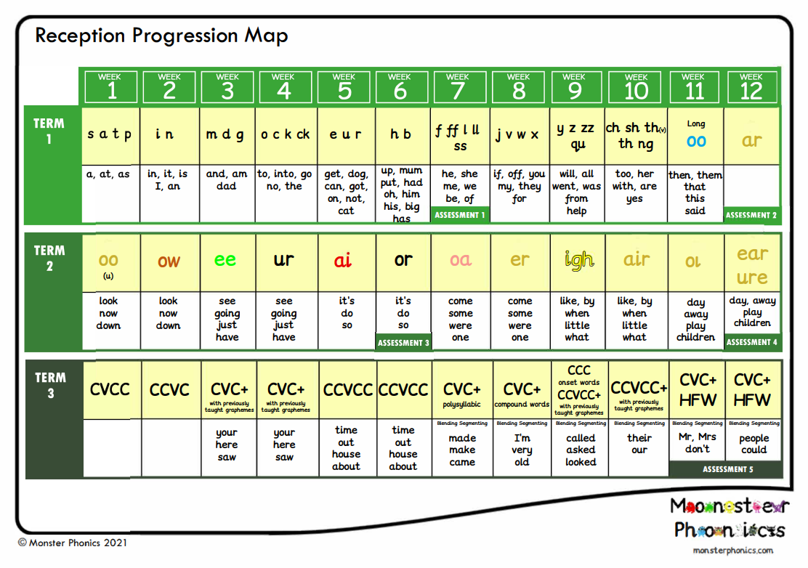
Year R Progression Map

Slide 12
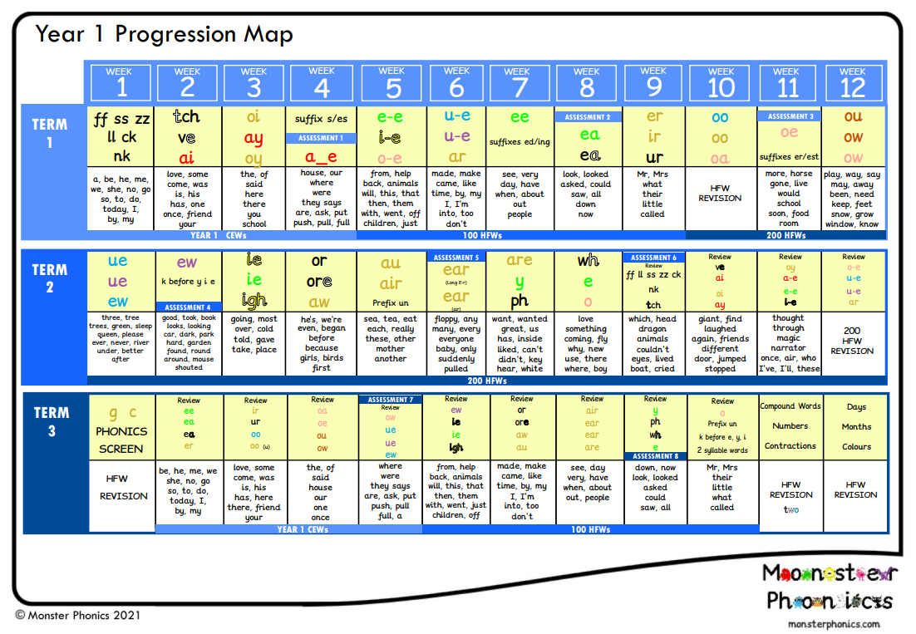
Year 1 Progression Map

Slide 13
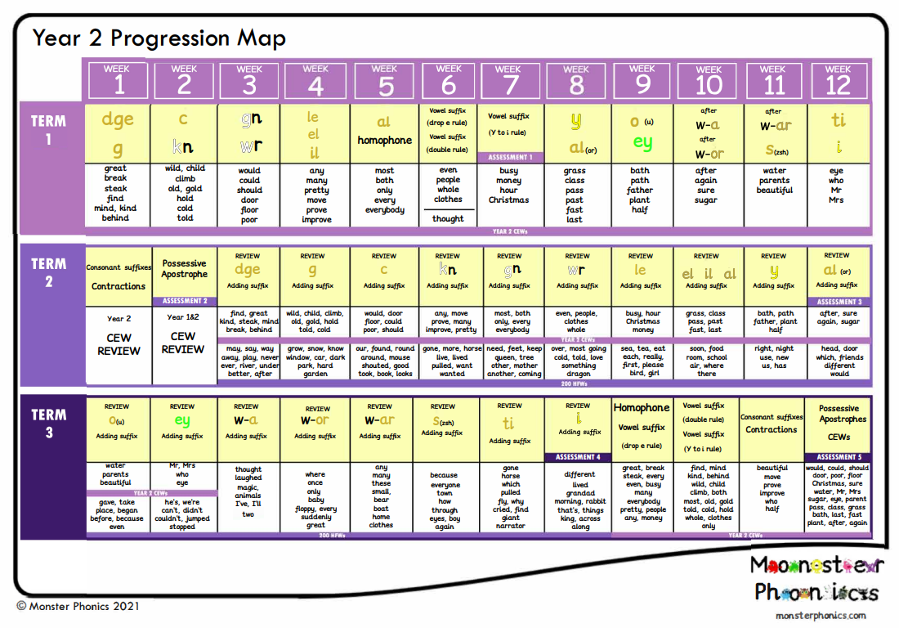
Year 2 Progression Map

Slide 14
Tricky Words
Words that are not phonically decodable
e.g. was, the, I
Children do not need to sound these words out
They are identified with a gold wand above them

Slide 15
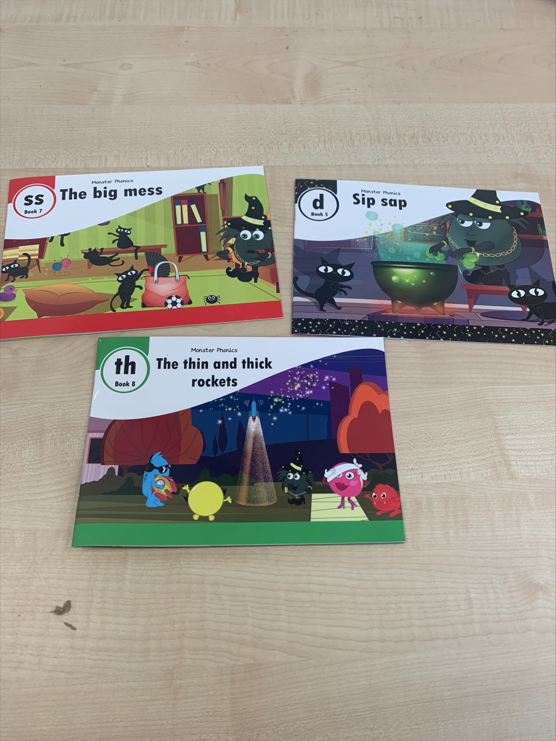
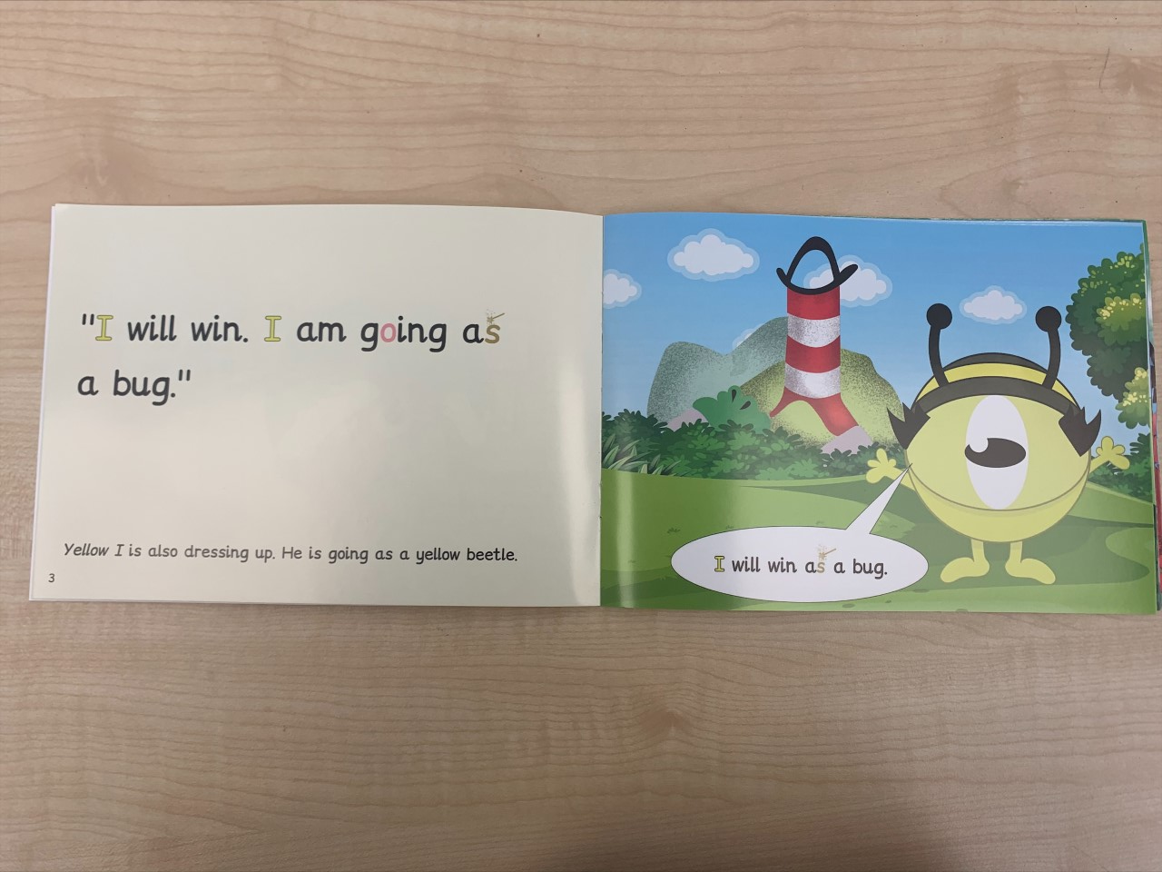
Our Reading Scheme
The books are matched to the phonics phase the children are working on.

Slide 16
Why is phonics so important to early reading?
Phonics is a way of teaching children to learn to read quickly and skilfully.
• Phonics gives children the confidence to read and decode words.
• Being able to decode is a crucial element to reading success.
• To be a fluent reader, children need to be able to draw on a variety of strategies such as picture clues, segmenting or decoding, blending and tricky word knowledge.
• Being able to decode aids children’s word recognition which supports reading fluency which in turn has a positive effect on reading comprehension.
• You will also see improved spelling ability.

Slide 17


The
Phonics Screening
check

Slide 18
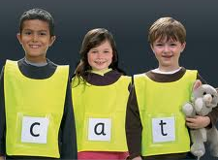
What is the check?
Every Year 1 child in the country will be taking the statutory phonics screening check in the same week.
The check is very similar to tasks the children already complete during phonics lessons.
The focus of the check is to provide evidence of children’s decoding and blending skills, not to test their vocabulary.

Slide 19

What will the children do?
The check takes approximately 5 to 10 minutes to complete.
They will be asked to ‘sound out’ a word and blend the sounds together. e.g. d-o-g – dog
The check will consist of 40 words and non-words;
Children will be told if the word is a real or ‘alien’ word, with a corresponding alien image.

Slide 20
How will it be administered?
Your child’s class teacher or the Phonics Lead will conduct all of the screening checks with the children;
The children will complete the check one to one in a quiet area of the school;
We are not permitted to indicate to the children at the time whether they have correctly sounded out and / or blended the word.

Slide 21
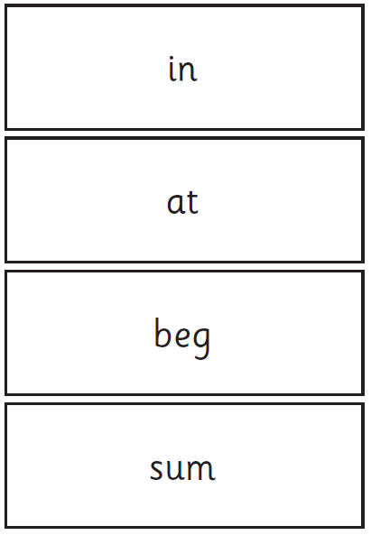
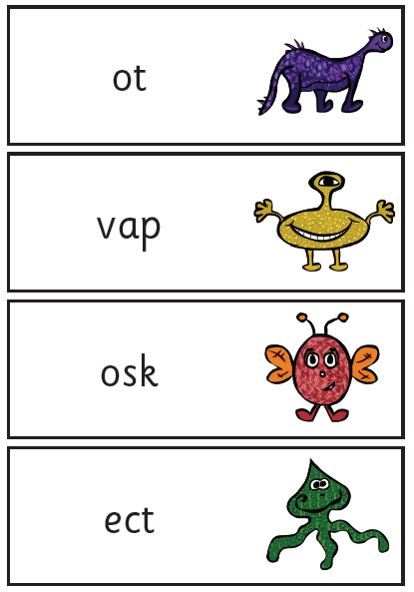
Examples of words

Slide 22
The screening check takes place in June 2026.
Children will be scored against a national standard (the threshold pass mark will be released after the check week)
We will inform you of whether your child falls within this standard or below, at the end of the Summer term.
If your child’s score falls below the national standard they will be expected to re-take the Phonics Screening Check when in Year 2 and will receive catch-up support.

Slide 23
Activities to support early reading and phonics at home
Make it fun and share as many books as possible.
• Encourage independence by giving them time to solve new words using meaning and visual clues.
• Revisit books. There is nothing wrong with reading a familiar book or a familiar text.
• Focus on how the reading sounds, as this will add more meaning to a story.
• Praise them in their efforts and make them feel as though they are achieving.

Slide 24
Links to support phonics at home
Information Sites
https://monsterphonics.com/how-it-works/
https://monsterphonics.com/free-phonics-worksheets/
Monster Phonics Pure Speech Sounds
Free Online Games
https://www.phonicsplay.co.uk/resources
https://www.topmarks.co.uk/english-games/5-7-years/letters-and-sounds
https://www.topmarks.co.uk/english-games/3-5-years/letters-and-sounds
Apps
https://monsterphonics.com/monster-phonics-apps/
School Website
Eardisley CE Primary School - Phonics

Slide 25
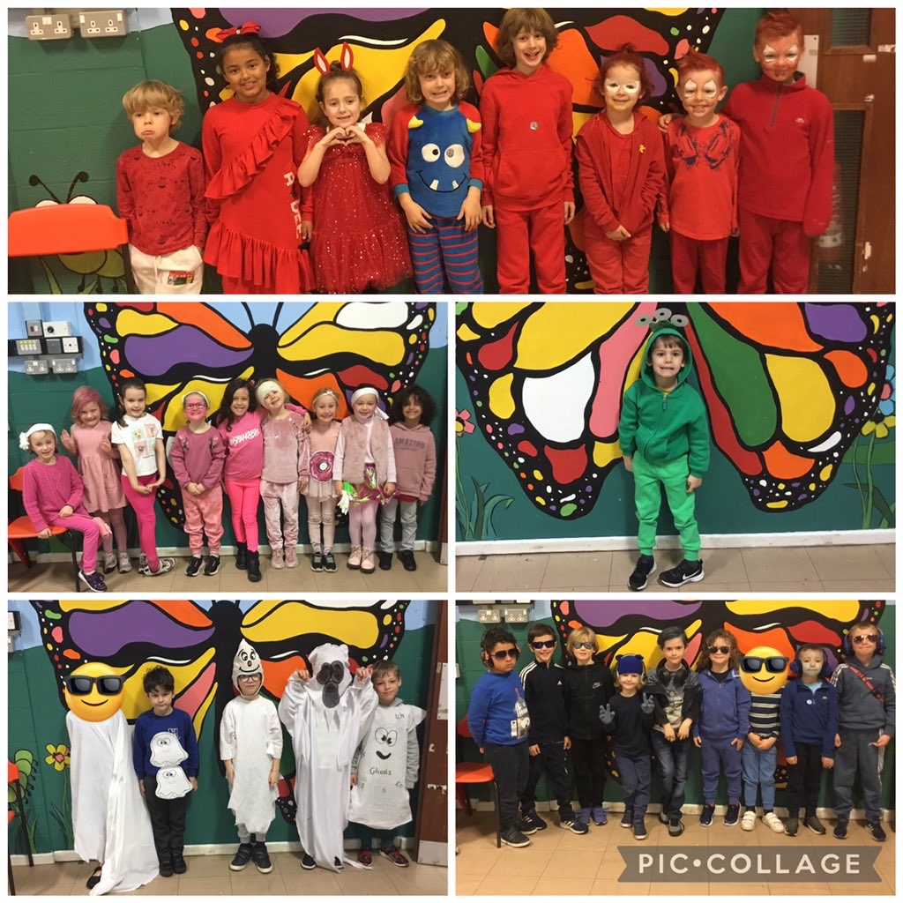
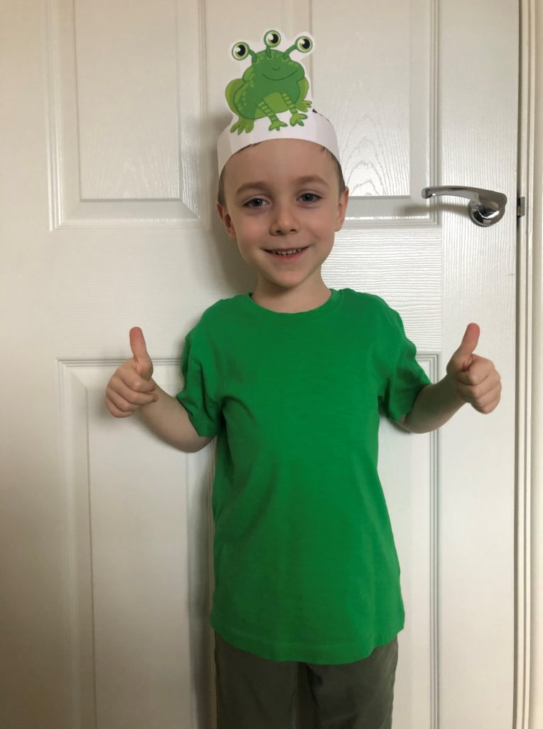
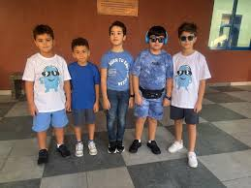
Monster Phonics Launch Day
Thursday 5th February
Children in Rowan and Beech may come in dressed as one of the characters or just wearing the colour of their favourite monster

Slide 26


